Slide 1

LLM Engineering
MASTER AI & LARGE LANGUAGE MODELS

Slide 2

DAY 3
Onwards
What you can do ALREADY
Understand the progression to become proficient
Have a first impression of the frontier LLMs
From Day 1: use OpenAI API to make summaries
What you'll be able to do today - deeper intuition into frontier
Compare the top Frontier models; Chat vs Reasoning
Appreciate what they do well
Recognize where they struggle

Slide 3



LLMS COME IN 3 FLAVORS
Better for fine-tuning to
learn a new skill
Base
Better for interactive use cases
and creative content generation?
Chat / Instruct
Hybrid
Better for problem solving
Reasoning / Thinking
“budget forcing”

Slide 4





Frontier models and their Chat Products
Open AI
Anthropic
Google
x.ai
DeepSeek AI
Models: GPT
Models: Claude
Models: Gemini
Models: Grok
Models: DeepSeek
Chat: ChatGPT
Chat: Claude
Chat: Gemini Advance
Chat: Grok
Chat: DeepSeek

Slide 5

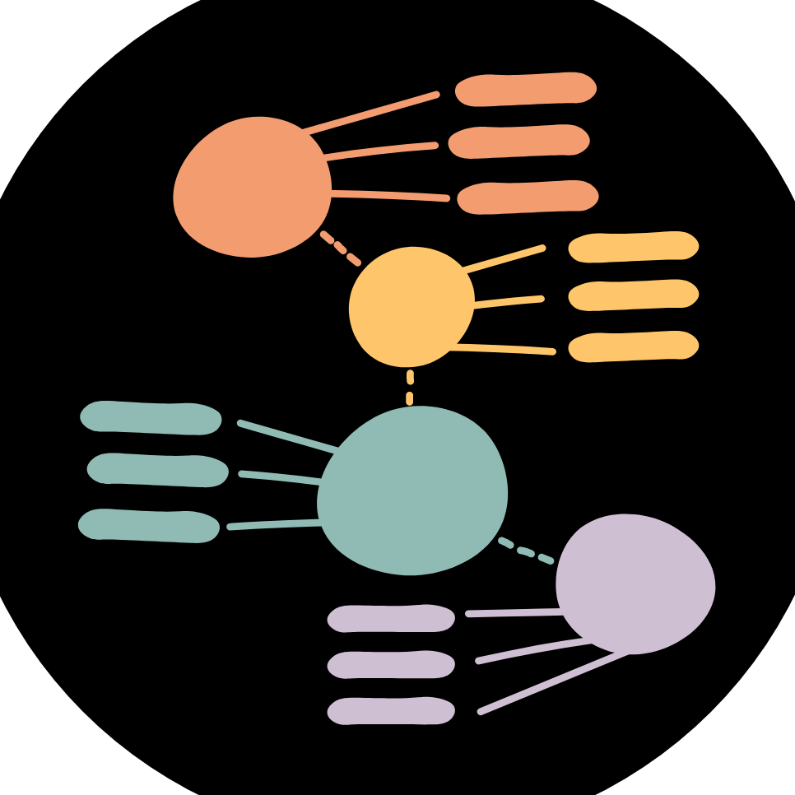

Mind-blowing performance from Frontier LLMs
Synthesizing information
Fleshing out a skeleton
Coding
Answering a question in depth with a structured, well researched answer and often including a summary
From a couple of notes, building out a well crafted email, or a blog post, and iterating on it with you until perfect
The ability to write and debug code is remarkable; far overtaken Stack Overflow as the resource for engineers

Slide 6



LIMITATIONS OF FRONTIER MODELS
Specialized domains
Recent events
Can confidently make mistakes
Most are not PhD level, but closing in
Limited knowledge beyond training cut-off date; code often uses legacy APIs / models
Some curious blindspots Can jump to conclusions when coding

Slide 7
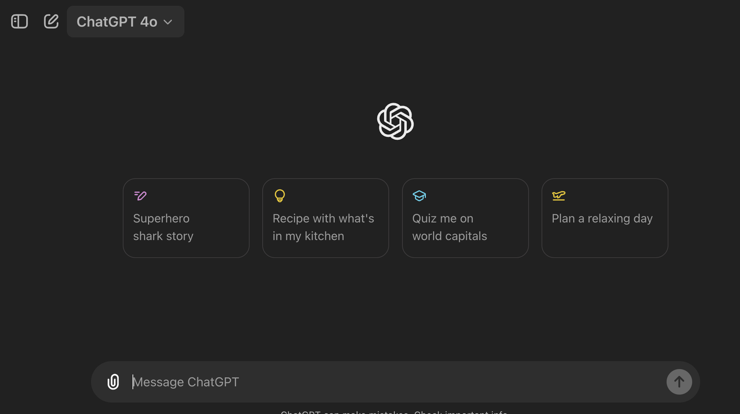
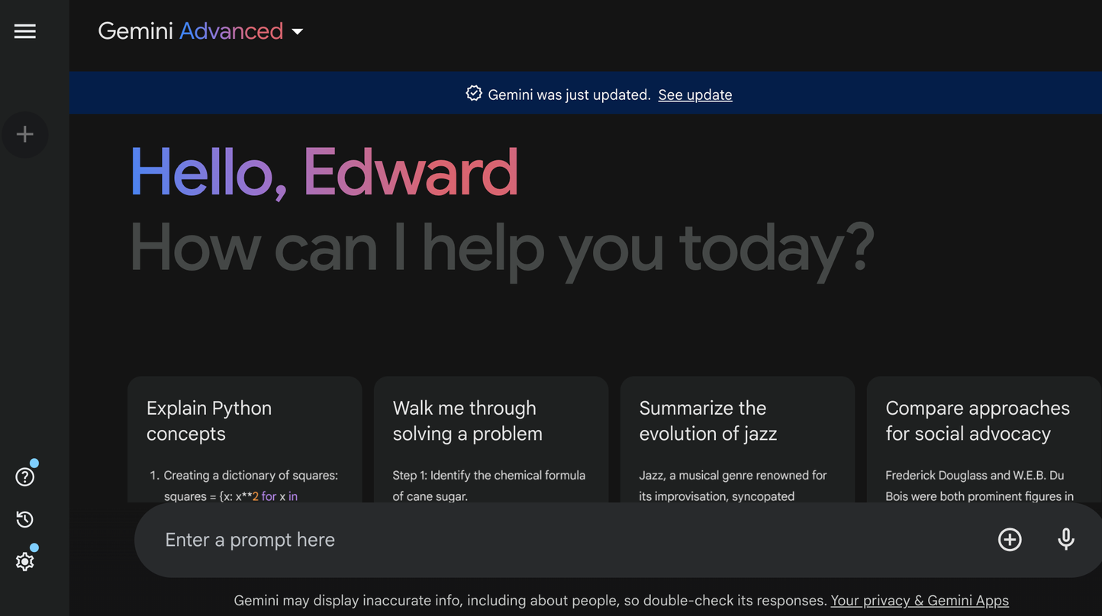
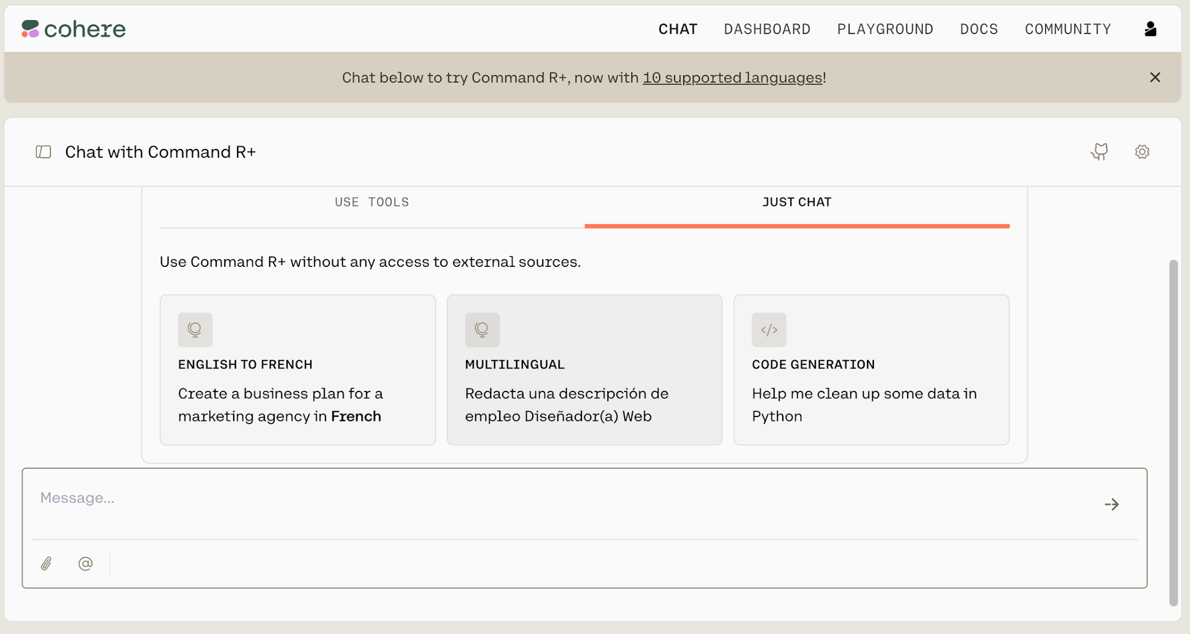
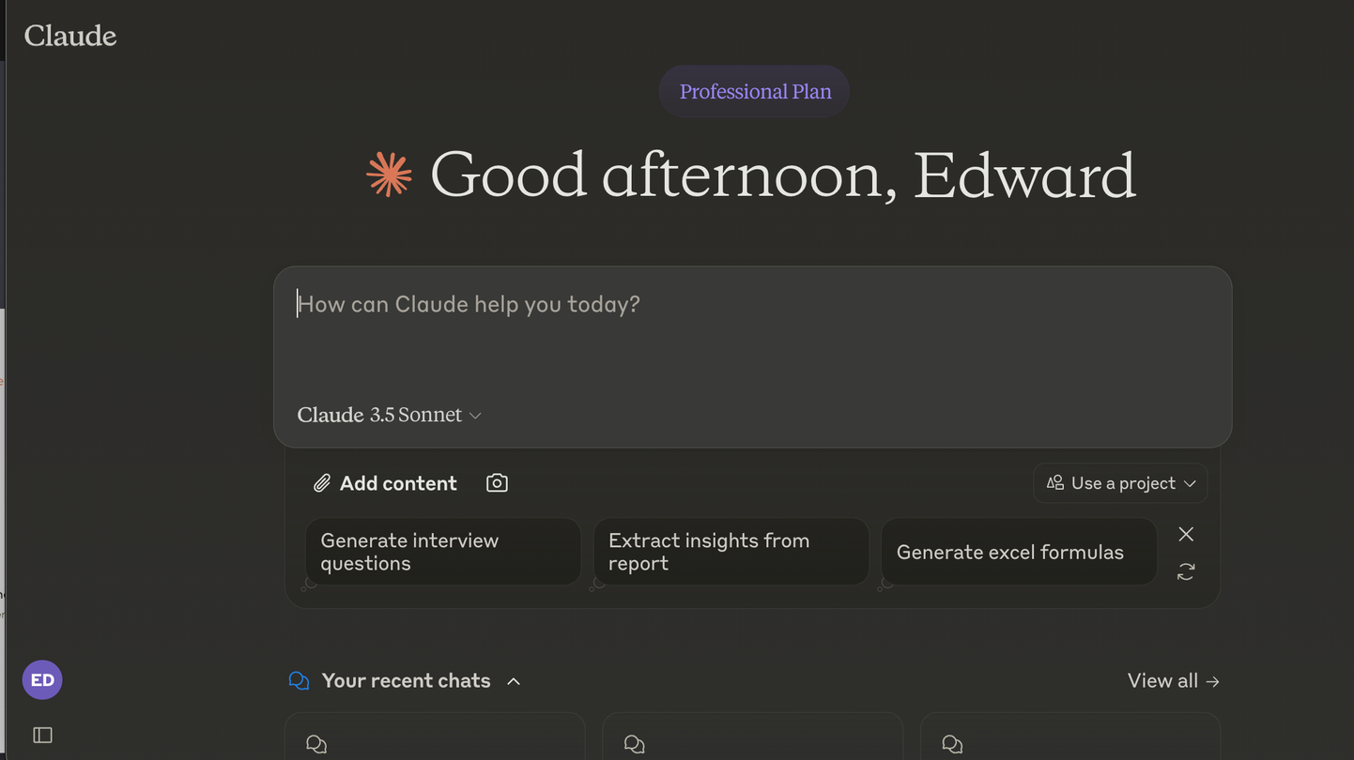
Let's try them out and compare
"How do I decide if a business problem is suitable for an LLM solution?"
"Compared with other Frontier LLMs, what kinds of questions are you best at answering, and what kinds of questions do you find most challenging? Which other LLM has capabilities that complement yours?"
"What does it feel like to be jealous?"
"How many times does the letter 'a' appear in this sentence?"

Slide 8



In conclusion
All Frontier LLMs are shockingly good
Claude tends to be favored by practitioners
As they converge in capability, price may become the differentiator
Particularly at synthesizing information and generating nuanced answers
More humorous, more attention to safety, more concise
Recent innovations have focused on lower cost variants

Slide 9

PROGRESS REPORT
Now 7.5% to mastery
What you can do ALREADY
Write code to call OpenAI's frontier models & summarize
Explain the strengths and limitations of Frontier LLMs
Compare & contrast the leading models; explain Chat vs Reasoning
What you'll be able to do TOMORROW
Describe the dizzying rise of the Transformer
Explain the latest: Agents, Context Engineering, Agent Loops
Understand tokens, context windows, parameters, API cost

